Slide 1
Articulated Object Manipulation
using Online Axis Estimation
with SAM2-Based Tracking
Xi Wang*, Tianxing Chen*, Qiaojun Yu*, Tianling Xu,
Zanxin Chen, Yiting Fu, Cewu Lu†, Yao Mu†, Ping Luo†

Slide 2
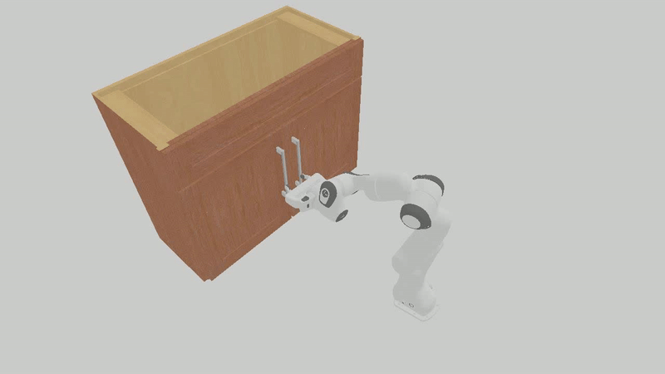
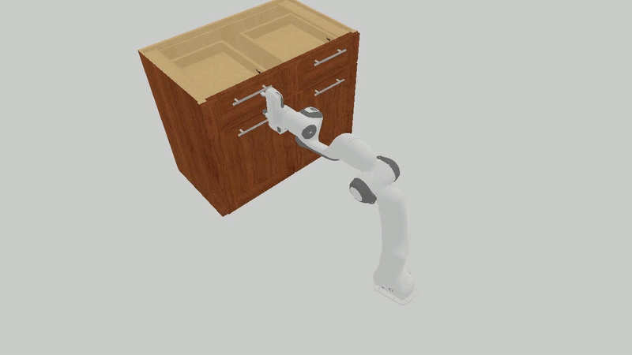
Motivation
Axis must be carefully considered
🔥
Challenging
😡
🥰
Articulated Object Manipulation
Open-loop Method
Open Door
Open Drawer
Controller
Motor
Lack of interaction dynamics

Slide 3
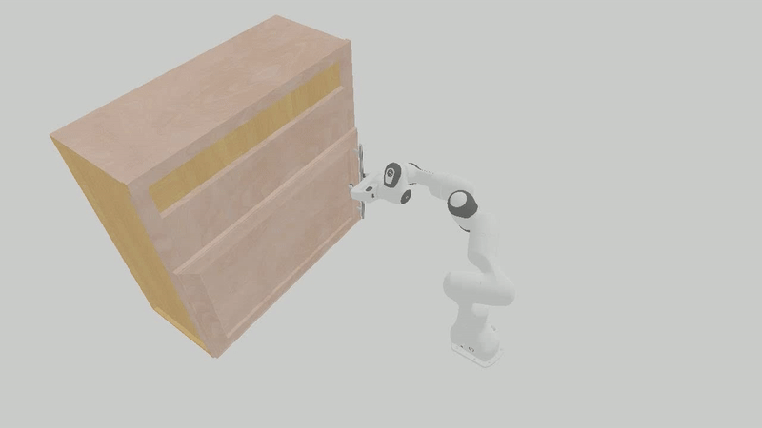
Innovation
😡
🥰
Articulated Object Manipulation using Online Axis Estimation with SAM2-Based Tracking
[1] Integrate the strengths of RGB-based methods and point-cloud-based techniques.
[2] A closed-loop pipeline fusing interactive perception and axis estimation.
[3] Online refined axis estimation obtained from segmented 3D point clouds with SAM2-based tracking.
Interaction Dynamics

Slide 4
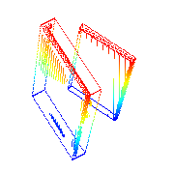
Pipeline
Interactive Perception &
Init-Manipulation Module
Tracking & Segmentation Module
Axis Estimation & Manipulation Module
Initial Observation
First Frame
Manipu
-late
Detector
…
Tracking
RGB-D
Frames
Init
RGB Frames
SAM2
Active Part Point-clouds
Interactive
Perception
Technique
RGB-D
Frames
Previous
Depth Maps
Scene Point Cloud
Frames
Tracking Mask
Frames
…
OBB
Pose Sequence
…
…
&
Current
Axis
Slight Movement
Observation
Object Tracking
Frames
Motion Part
Frames
Explicit
Axis Estimation
…
…

Slide 5
Simulation Experiment
Tasks
Targets
Basic
8.6°
Open Door
More challenging
20 °, 30 °, 40 °, 45 °, 50 °, 55 °, 60 °, 65 °, 70 °
Basic
15 cm
Open Drawer
More challenging
20 cm, 25 cm, 30 cm, 35 cm, 40 cm, 45 cm

Slide 6
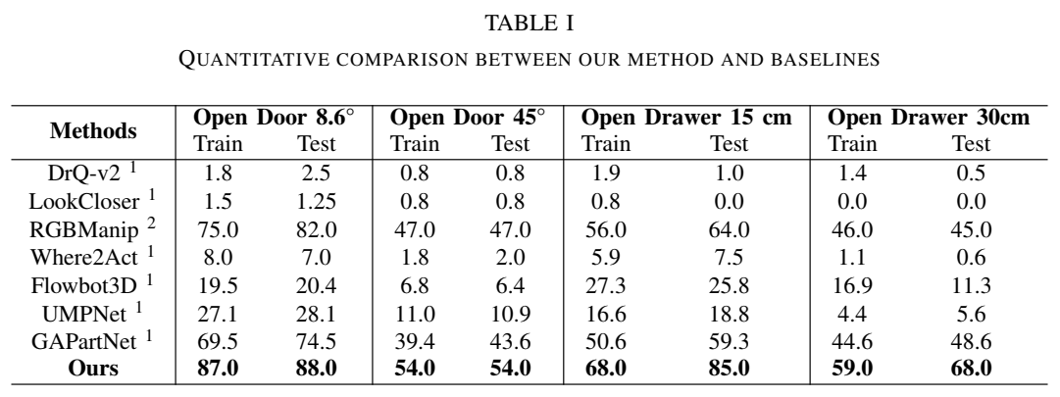
Results of Basic Tasks

Slide 7
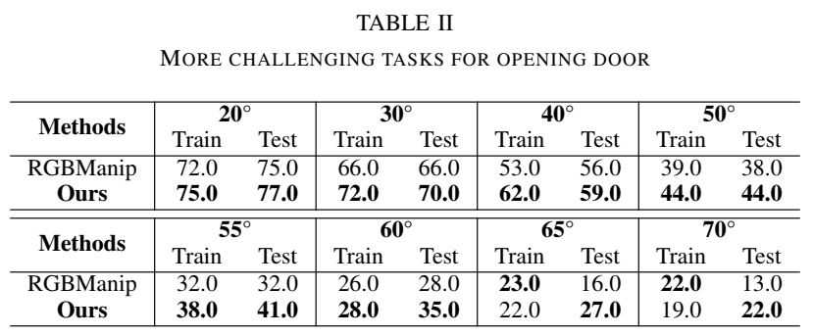
Results of More Challenging Tasks

Slide 8
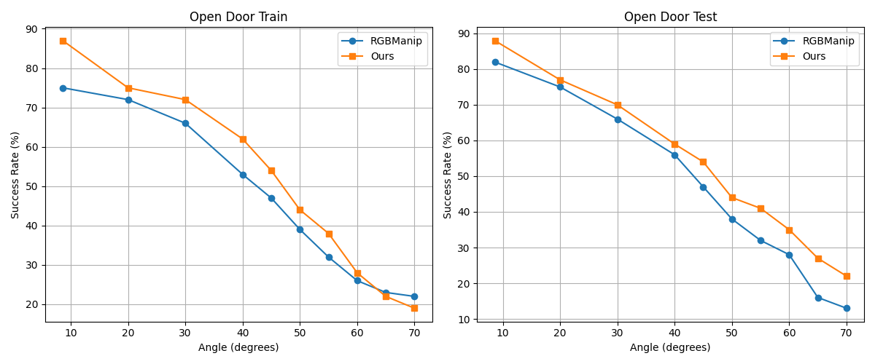
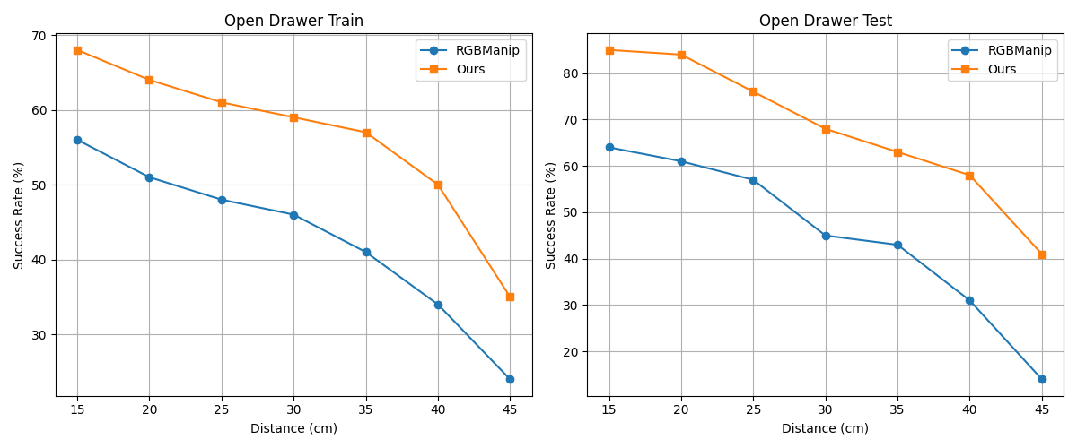
Results of More Challenging Tasks
Tasks
Results
Open Door
Open Drawer

Slide 9
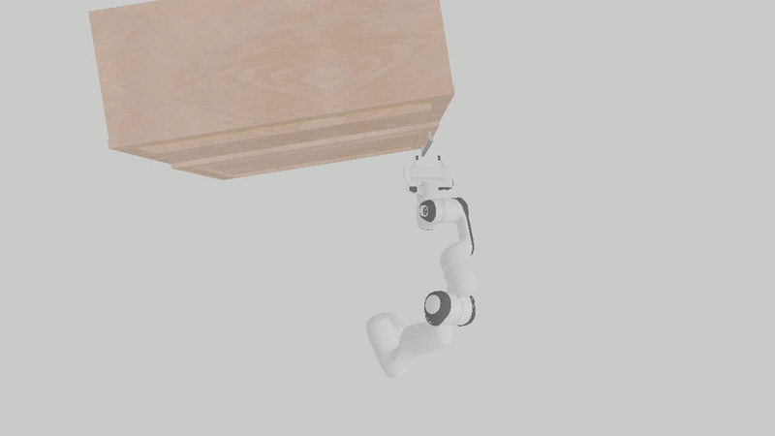
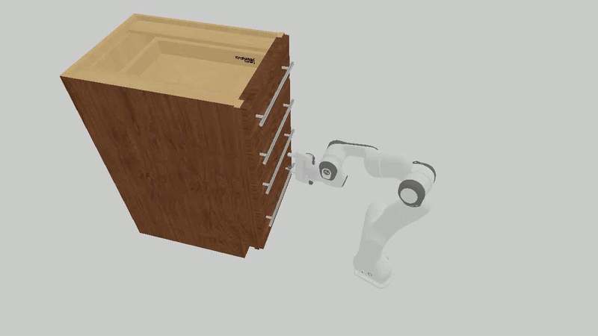
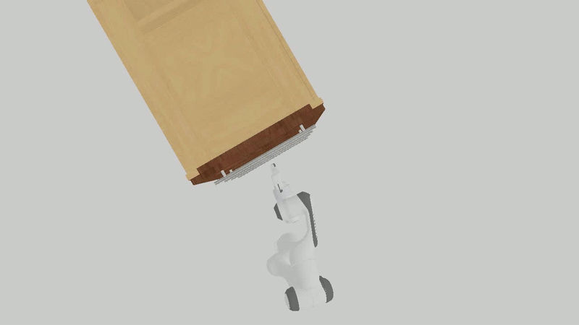
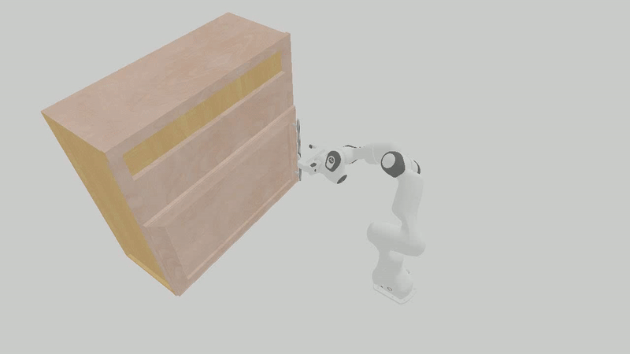
Visualization
Open Door
Open Drawer
Top View
Side View

Slide 10
Articulated Object Manipulation
using Online Axis Estimation
with SAM2-Based Tracking
Xi Wang*, Tianxing Chen*, Qiaojun Yu*, Tianling Xu,
Zanxin Chen, Yiting Fu, Cewu Lu†, Yao Mu†, Ping Luo†
🥳Thanks for watching!

Slide 11
Motivation

Slide 12
Motivation

